Slide 1
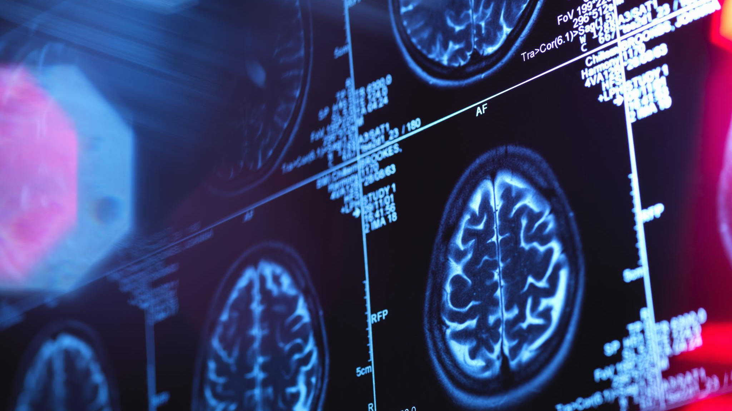
Using a CNN to determine stage of Alzheimer’s disease from images

Slide 2
The Dataset
Pre-separated into training and test sets
208 by 176 black and white 2D brain scans
Total 5121 images in training set, 1279 in test set
Divided into four classes: no Alzheimer’s (2560/640) , very mild Alzheimer’s (1792/448) , mild Alzheimer’s (717/179), and moderate Alzheimer’s (52/12)
Imbalanced data requires oversampling, undersampling, or a weighted loss function

Slide 3
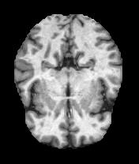
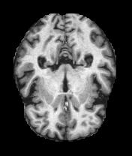
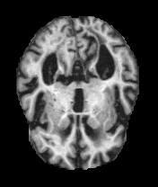
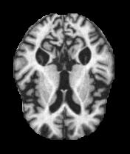
Examples of each stage:
NonDemented
VeryMildDemented
MildDemented
ModerateDemented

Slide 4
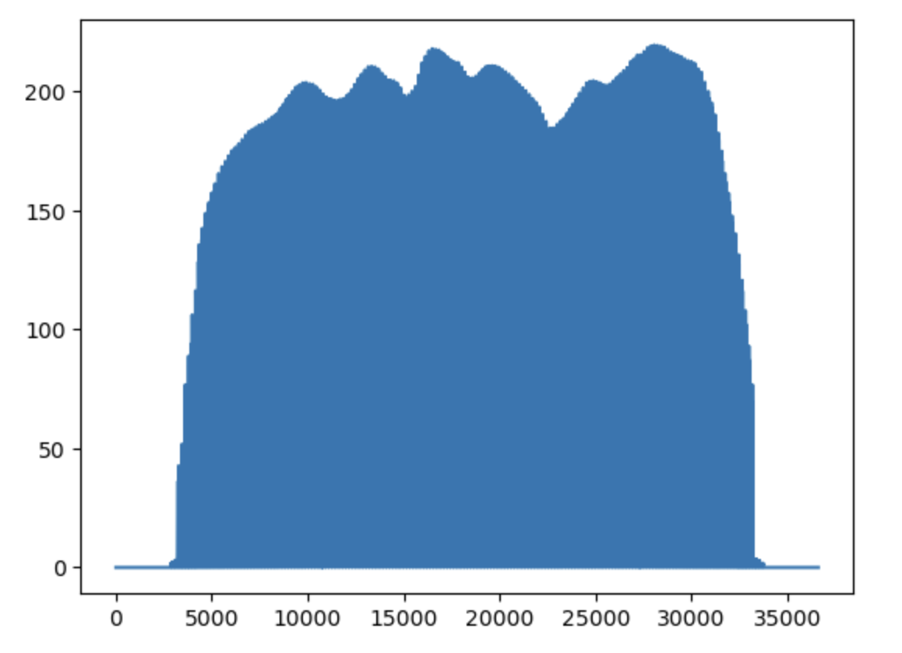
Data Exploration

Slide 5
Classification or regression?
Since there are classes, this would seem like a classification problem
None of the classification losses take into account the ordinal nature of these classes!
I use regression instead to account for this

Slide 6
Imblearn oversampling
Imblearn is a module designed for imbalanced datasets, and offers both undersampling and oversampling options
I used oversampling because undersampling would give me barely any data to work with
Focal loss can’t be used because it’s regression, so a custom loss function would be needed if I don’t oversample or undersample
I oversample every non-majority class to the size of the majority (only for training set since test set is for seeing how it performs with the actual data!)

Slide 7
Validation testing the original neural network
I started out with three convolutional layers of (3,3) kernel size each, stride of 1, filters going from 6 to 12 to 16 (this was modeled after workbook 8), followed by dense layers. At Professor Burdis’s suggestion I quickly changed from 120/80/20 dense layers to 40/20 to avoid an exceedingly large number of parameters while having few images. This was followed by a one neuron final layer with linear activation to do a regression (all other layers were relu). I used Adam as my optimizer.
I used MSE loss and metric because confusing, for example, no Alzheimer’s with moderate Alzheimer’s would be a very serious error, so I wanted to heavily penalize large errors.
Epochs = 50
Batch size = 256

Slide 8
Parameter search with averaged kFold (folds = 5)
For reference: Variance of data set = 1.25
Original parameters: MSE = 0.0765
With SGD: MSE = 0.2787
With Adamax: MSE = 0.1807
With Adam and the last layer at 5,5: MSE = 0.0569
With Adam and stride 2 for the last layer: 0.1422
Also tried (and did not get higher scored than my best option):
3,3/5,5/7,7
3,3/5,5/5,5
Four 3,3 layers

Slide 9
resNet transfer learning
Transfer learning could avoid the problem of a small dataset by using a neural network trained on other data
Still used Adam and MSE loss
Pretrained model with frozen layers + Flatten + 40/20 dense layers and final linear regression layer
Unfortunately I did not seem to have the computer processing power to run this, it crashed my kernel every time, but I kept the code I used for it.

Slide 10
Performance on training data
Initial performance on training data was 0.679 – massive overfit compared to what I got on kFold
I realized using the same neural network over again meant it was already trained on most of the data and started at a lower loss, making it effectively 100 epochs
After creating a new identical network to fix this, I still got loss of 0.497 – not ideal?

Slide 11
Experimenting with overfit
Maybe could be caused by test set not being imbalanced – even a good predictor for more severe Alzheimer’s is statistically likely to be wrong more often when there are fewer examples
Tried creating a oversampled test set to test this hypothesis (actually two, as you cannot transform oversampler without fitting; one with entirely new oversampler and one with the old oversampler refit)
Got 0.759 and 0.632
Reducing epochs to 30 (while creating a new network)got 0.536 score; overtraining is not the issue

Slide 12
Conclusions
While my final predictions were still well above the variance, the large overfit is not ideal
Overfit may actually be caused by the oversampling; basing the moderate oversamples, for instance, on the 52 severe samples in the training set means that the training and test folds will actually be working with almost the same data, making it not equivalent to the training/test contrast
This problem would be enhanced by oversampling the test set and thus having more of the result depend on the oversampled classes, which explains why I got worse scores for that experiment
In the future, I would want to create a custom loss function to account for the imbalance without causing this problem

